Slide 1

Employee Attrition at IBM
Data Cleaning/ Plotting/ Insight

Slide 2
why is attrition an important topic ?

Slide 3
Dataset Content
1470 rows X 13 columns

Slide 4
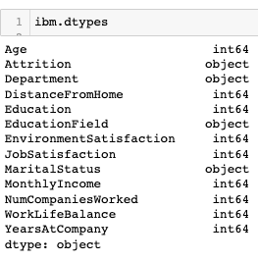
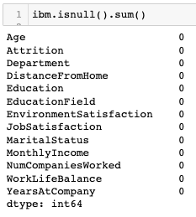
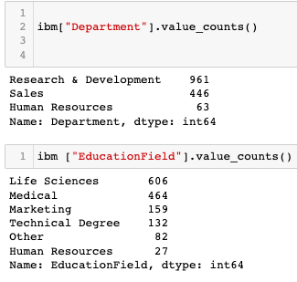
Dataset Preparation
Displaying the Data
Missing Data/Outliers
Data Processing

Slide 5

Outcome of the Data Cleaning
State of the Dataset
Data Type
Numeric
Categorical

Slide 6

Plotting
1- Understanding our Employee’s background

Slide 7
Different types of variables
Continous variables : Histograms, boxplots and scatterplot, counterplot, JoinGrid,kdeplot. This gives us understanding about the central tendency and spead.
Categorical variable : Bar chart, pie chart showing frequency in each category

Slide 8
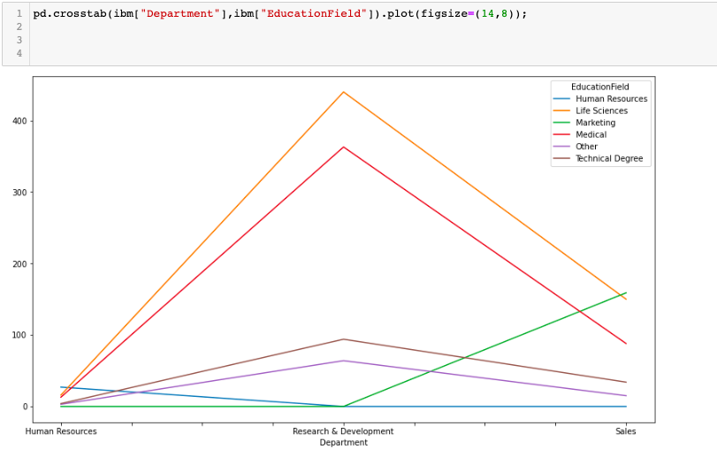

Slide 9
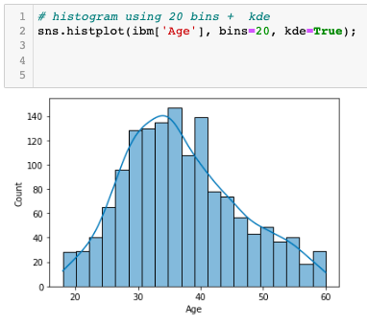

Slide 10
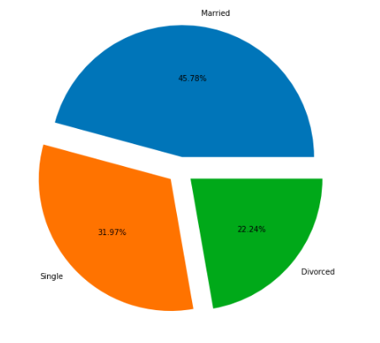

Slide 11
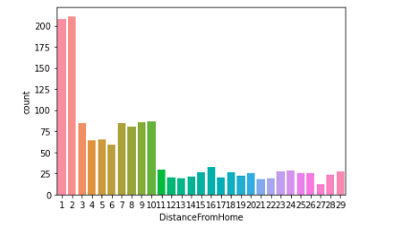

Slide 12
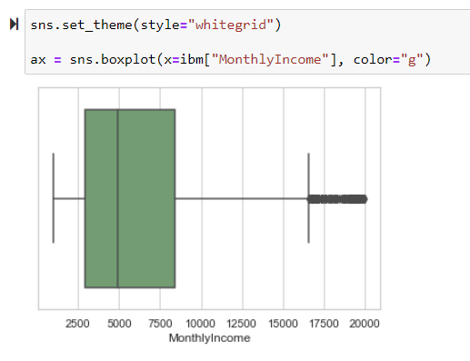
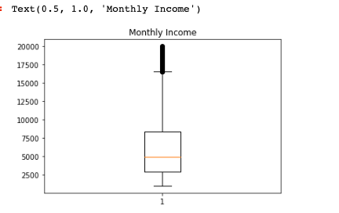

Slide 13
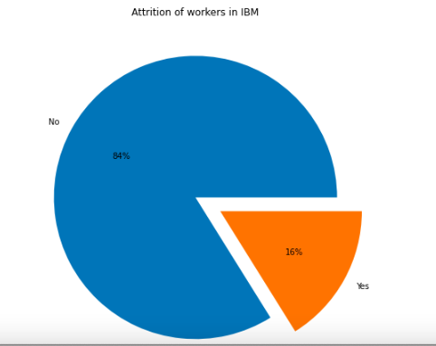

Slide 14
From the previous result, we can find that about 84% of people stick to the company while rest of them quit

Slide 15
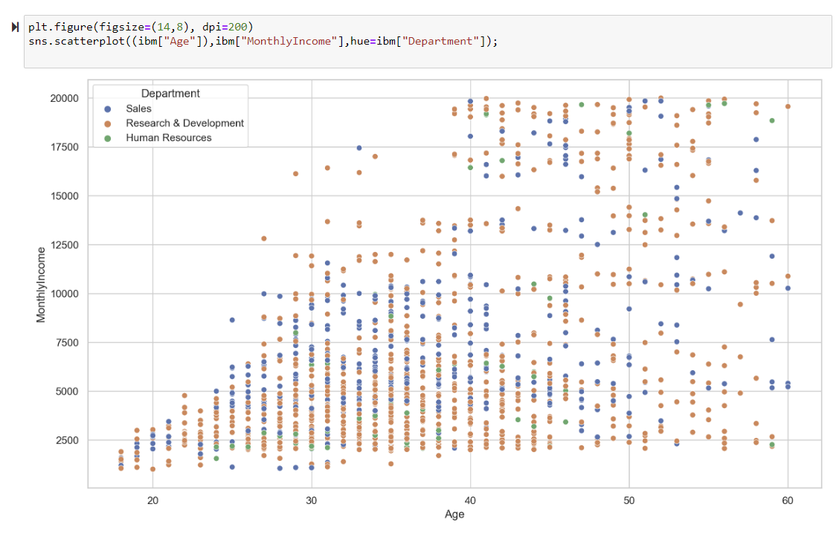
This scatter plot tells shows that most employees who are less than 30 and who worked less than 5 years want to leave the company.

Slide 16
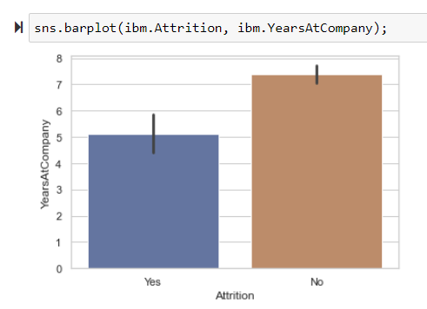

Slide 17
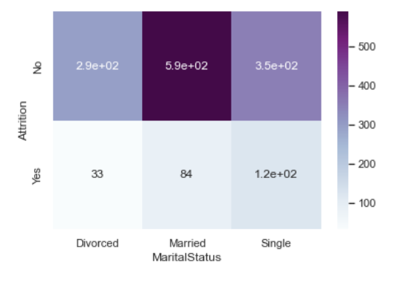

Slide 18
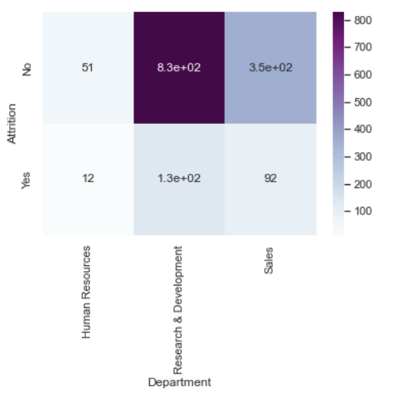
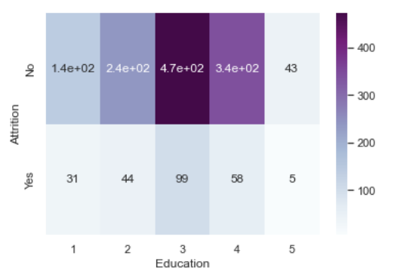

Slide 19
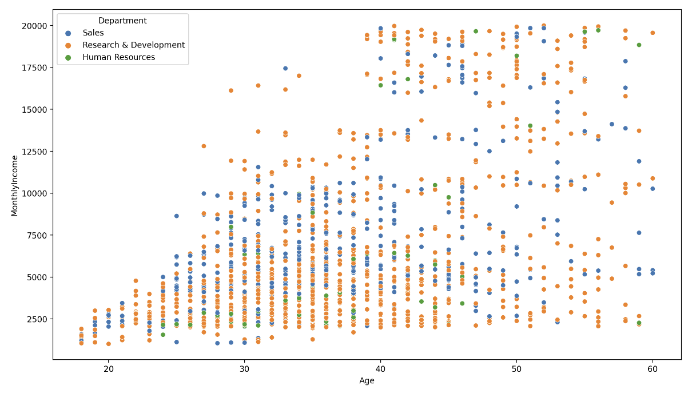
Analysis of Monthly income with Age of Employees in Department wise

Slide 20
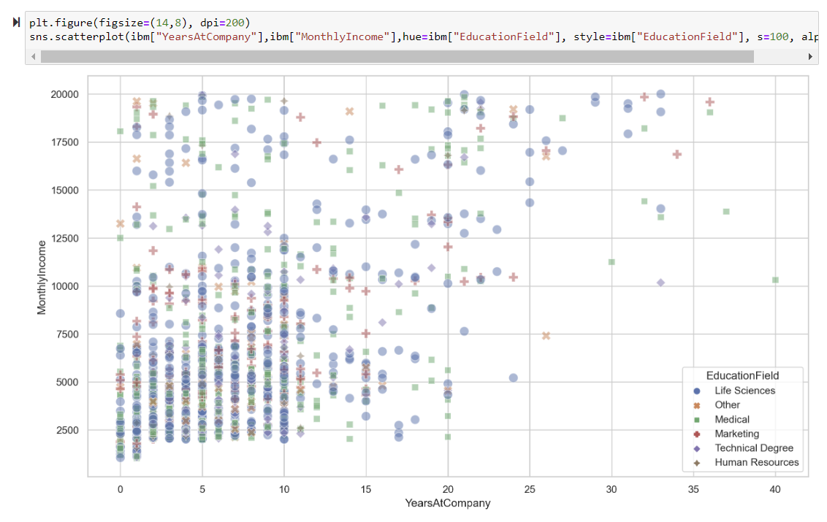
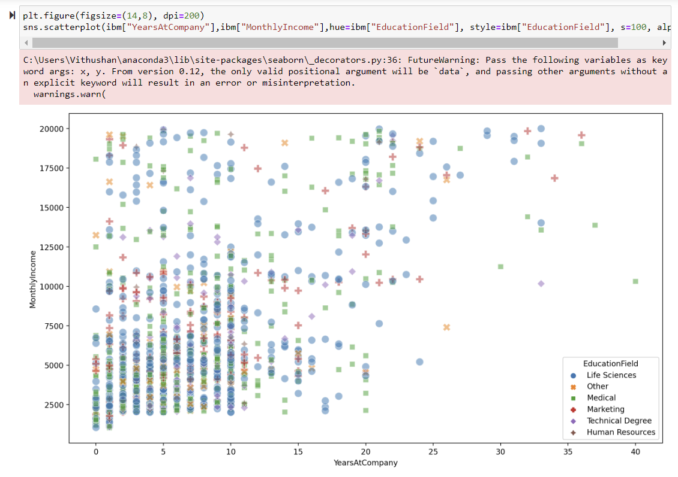
Analysis of monthly income and Years at company in Educational Field

Slide 21
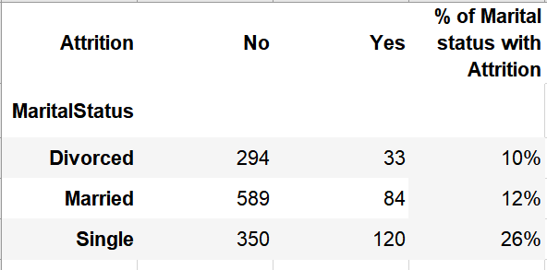

Slide 22
Some General Insight
Educational background the department are
hightly related
Singles have higher rate of attrition 25%
New hires are more likely to leave the company
This plot tells that there are more employees in the range of 30 to 40. Approximately 45% of employees fall in this range.
Employees whose age is in the range of 30 - 40 are more likely to quit.
Employees in the range of 20 to 30 are also equally imposing the threat to employers

Slide 23
Challenges
Vithu Doesn’t like Netflix !!!!

Slide 24
More seriously
The Dataset was very clean, so clean that we didn’t have that many elements we could compare,
-Gender
-Daily rate
-perks of the job…

